Slide 1
Chromebooks in SQA Examinations for candidates who use Assessment Arrangements
Paul Nisbet, Robert Stewart, Craig Mill, Shirley Lawson & Allan Wilson
CALL Scotland, The University of Edinburgh

Slide 2
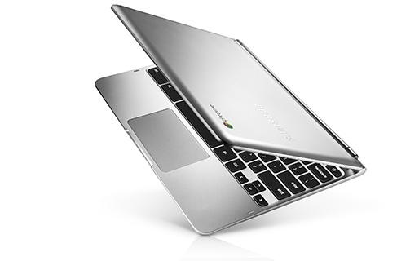
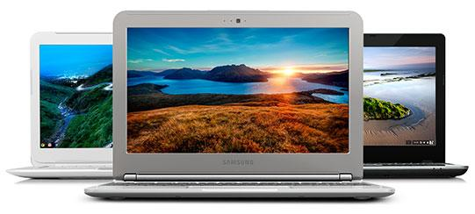
Chromebooks
“Chromebooks are a new type of computer designed to help you get things done faster and easier. They run Chrome OS, a operating system that has multiple layers of security, built-in cloud storage, and the most popular Google products for education built-in.”
“Chromebooks update themselves automatically, for free, so you always get the latest software and security updates. You'll never need to purchase or install upgrades manually.”
~ £200
https://www.google.co.uk/chrome/education/

Slide 3
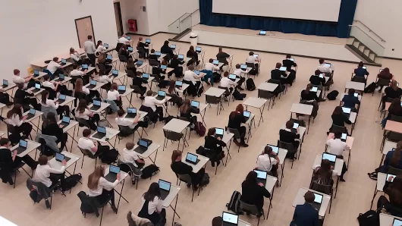
Chromebooks in examinations
Device management and security
Loading Digital Question Papers to the device
Reading & accessing papers
Typing answers / Digital Answer Booklets
Printing
“BHS Chromebook rollout continues. S3 got them Monday. Completing SNSA yesterday and today. Really positive feedback from pupils/staff/parents. Administering SNSAs very straightforward...”
Ally Mills, Brechin High School

Slide 4
Device management and Security
Chromebooks need a robust internet connection.
Schools must set up a domain.
Chromebooks need a Google G Suite account.
Set up each Chromebook with an ‘exam’ Google G Suite account.
Use the G Suite Admin Console to:
restrict access to internet using a blacklist (with exceptions such as Google Drive, Google Docs and the PDF reader);
install the necessary apps and extensions;
configure the ‘pinned’ apps;
block all other apps and extensions;
oconfigure the ‘pinned’ apps.

Slide 5
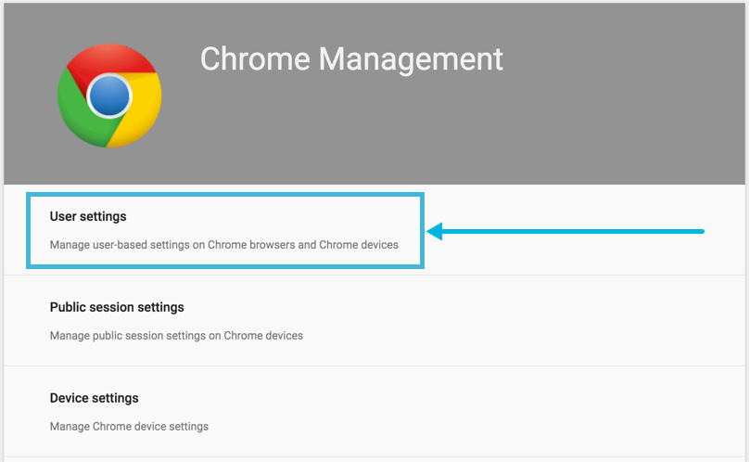
Device management and Security
Google admin requires:
A domain name to register the account against;
Emails (using the registered domain) for each of the ‘exam’ accounts;
A licence (paid for) for each device.

Slide 6
Loading Digital Papers
Open the CD or download the paper.
Copy the paper into the Google Drive folder for each ‘exam’ account.
Candidates log on to the Chromebook and the ‘Google Drive icon is sitting on their ‘shelf’ (bottom toolbar)
They open the paper and then choose their preferred app/extension.

Slide 7
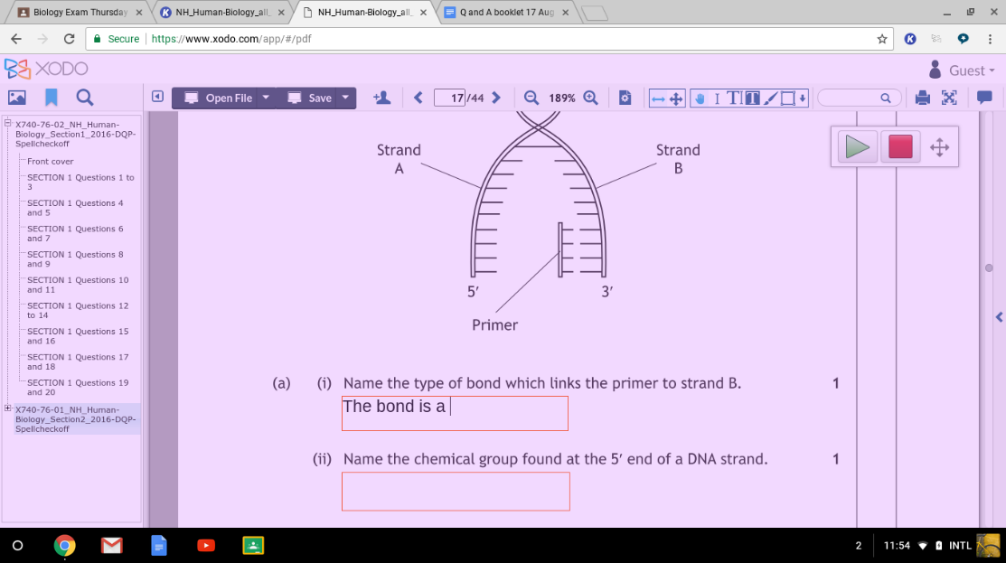
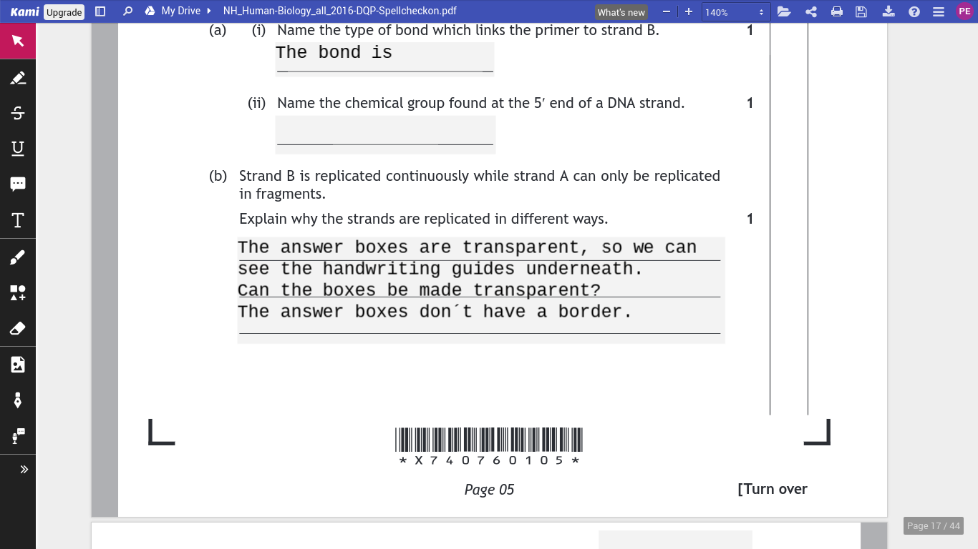
Reading and accessing papers
Question-only PDFs – many apps available.
Question and answer papers:
Kami
Xodo

Slide 8
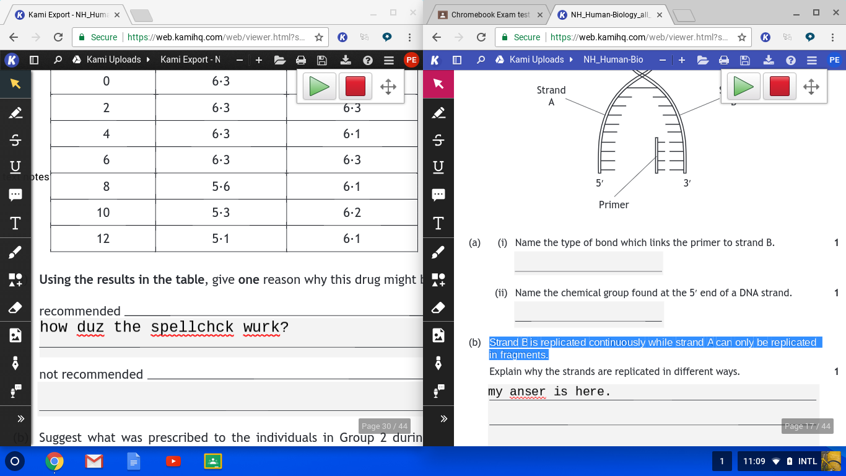
Text readers
ClaroRead Chrome Extension
Read&Write for Google Chrome
No Scottish voices (yet)

Slide 9
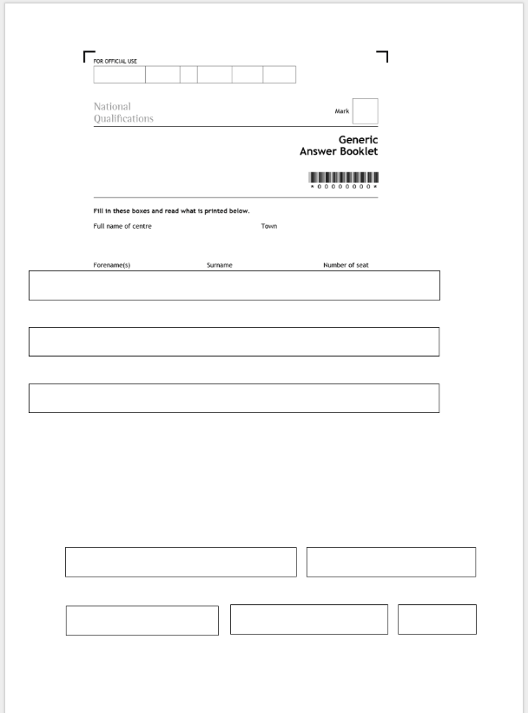
Typing answers / Digital Answer Booklets
Google Docs
Google Voice Typing
Spellchecker
Literacy support tools
Word Online
SQA DABs are not accessible

Slide 10
Printing
Print over the network;
Printers can be added via Google Admin using ‘Native Chrome OS Printing’.

Slide 11
Summary
Chromebooks are low cost, and easier to manage than Windows laptops.
Assistive software is relatively immature compared to Windows.
Accessibility options are limited especially compared to iPads.
No Scottish voices.
Anyone interested in collaborating with CALL?
Find out more:
Google Education Group (GEG) Scotland.
Google for Education
G Suite via Glow

